Slide 1

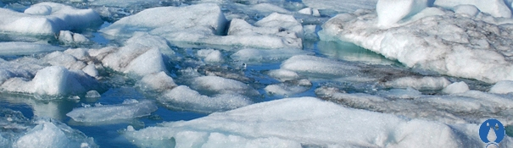
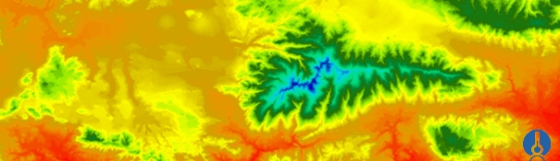


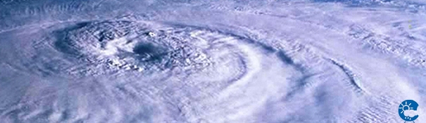
ENEON first workshop
Observing Europe: Networking the Earth Observation Networks in Europe
21-22 September, Paris
Workshop objectives and anticipated outcomes
Ivette Serral, Hans-Peter Plag

Slide 2
Motivation
ConnectinGEO is caring out a consultation process in the current EO Networks using collaboration platforms, surveys, discussions and workshops [ConnectinGEO methodology thread nº 3 of 5]
ConnectinGEO will integrate in-situ networks metadata into the GEOSS Common Infrastructure in a case by case basis [ConnectinGEO Hands-on challenge nº 3 of 5]
ConnectinGEO will select an interdisciplinary topic (global change challenge) and analyze EO Networks that can provide the needed data and determine if the collaboration between these networks can improve data products and save costs [ConnectinGEO Hands-on challenge nº 5 of 5]

Slide 3
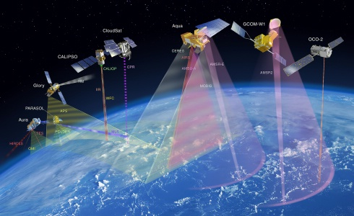

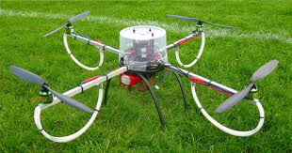
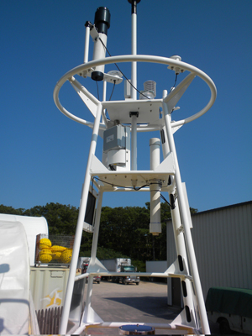
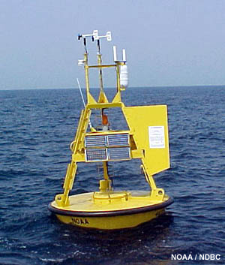
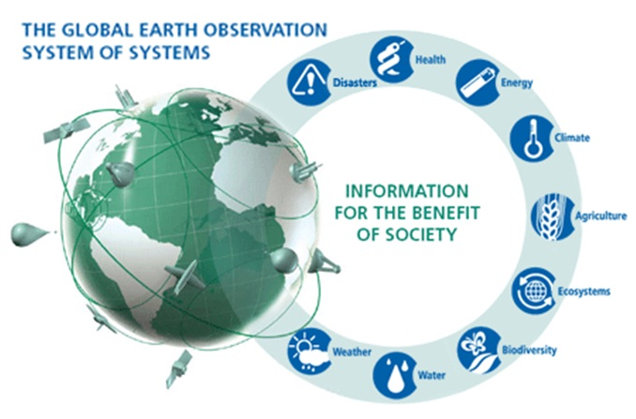
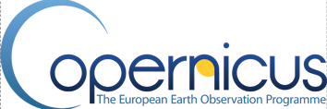

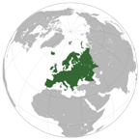

Connectin INTEGRATION METHODOLOGY
National and European actions and funding
SDG
indicators
UN report
Sustainable development goals
Consultation process
Priorities
S&T
stakeholders network
(models and forecast)
SEE IN Knowledge Base
Observation
needs
Industry stakeholders & Industry Challenges
Challenge
outcomes
Essential Variables and gap analysis
Previous inventories & analysis
Observation networks and CoPs
Observation
inventory
Consultation process

Slide 4
Can ConnectinGEO improve coordination between EO Networks while conducting the gap analysis?
ConnectinGEO will have some instruments of communication and collaboration with EO networks
  One instrument is ENEON
ConnectinGEO and the EC aim to increase communication between networks and guarantee good coordination between the networks to have a comprehensive coverage of the Earth state and evolution

Slide 5
ENEON brief introduction
ConnectinGEO has the compromise of constituting a European Network of Earth Observation Networks as an instrument to help the gap analysis and prioritization.
ConnectinGEO can help ENEON to:
  be a forum for discussing gaps in the EO networks and propose concrete solutions to the EC in terms of completeness and continuity both in-situ and space based.
  be a coordination point for the European contribution to GEOSS in in-situ networks
  encourage the alignment of a transversal set of Essential Variables

Slide 6
Workshop objectives
Know more about the main current Earth Observation networks in Europe.
Review previous umbrella initiatives.
Know more about data capture scales and frequencies.
Know more about gaps in data acquisition and sharing.
Clarify the need for a ENEON and overlaps with parallel initiatives.
Develop a strategy to setup the network of networks and for its sustainability.

Slide 7
We have prepared some questions to be answered by the networks to allow better discussions about:
  network characteristics
  data products (acquisition, sharing, etc)
  network of networks
The analysis and the results will be:
  included in a report to the EC
  part of the gap analysis study
  an indication of the ENEON need and benefits

Slide 8
Questions to be answered by the networks (1/3)
1. About your network
  1.1 Brief introduction about you and the network you are representing and the topic
  1.2 How large is your user base?
  1.3 What form of commitment do you have?
  1.4 How is the cost of maintaining the networks (just to give an idea of the magnitude to be weighed against the benefits). Who are your funding sources?
  1.5 Do you have problems keeping your network running?

Slide 9
Questions to be answered by the networks (2/3)
2. About data
  2.1 What data your network produces?
  2.2 What are the limits of your network (spatio temporal)?
  2.3 Is the data shared? To whom? In what conditions/license?
  2.4 Do you address data quality in some way?
  2.5 Which data you know that is needed but is not captured by your network or by other networks that you have access to?
  2.6 What key interface standards do you use?
  2.7 Is there risk of data continuity lost (Data preservation and data acquisition continuity)?

Slide 10
Questions to be answered by the networks (3/3)
3. About a network of networks
  3.1 What interfaces do you have with other networks?
  3.2 Are there additional interfaces that would be desired?
  3.3 Do you think that your network can benefit from the existence of an ENEON or a similar network?
  3.4 From your point of view how this network of networks should be managed?
  3.5 Is your network contributing to GEO(SS) and how ConnectinGEO can help you in better participating?

